Slide 1
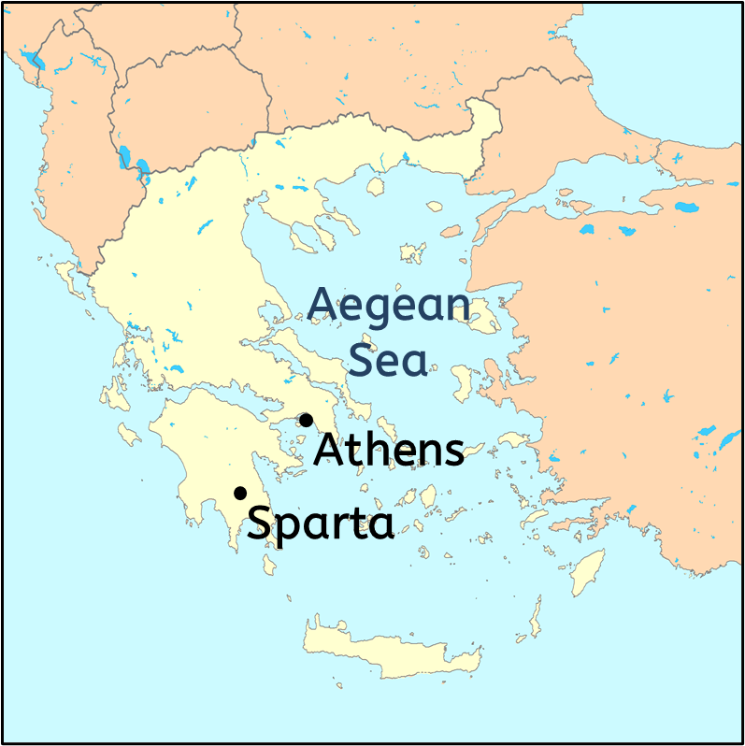
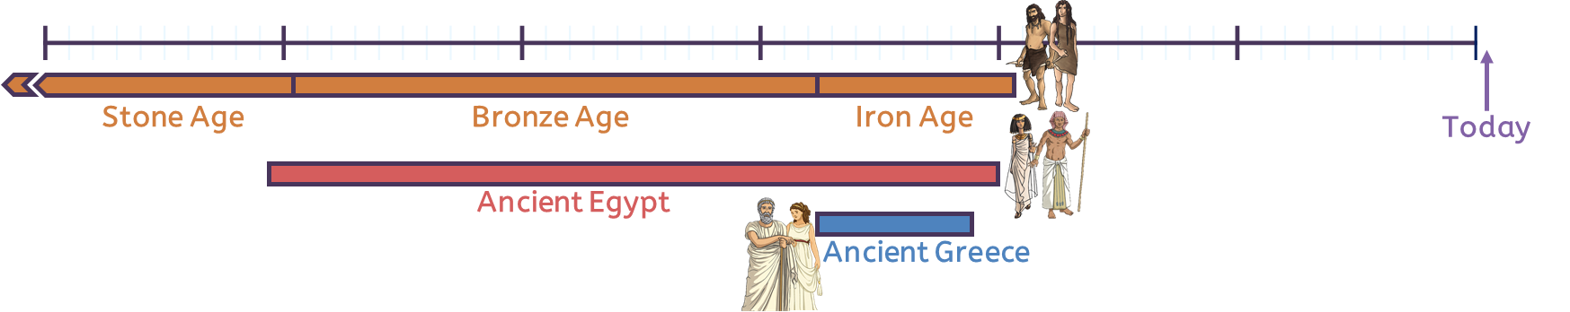
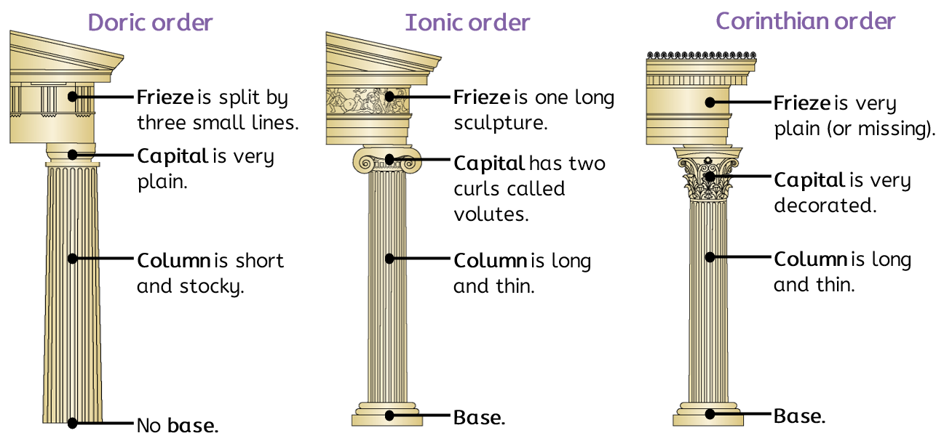
There are four different knowledge organisers provided in the following slides.
Teachers should select or edit as appropriate for their school and pupils.
Ancient Greece
Ancient Greece was made up of lots of city-states, like Athens and Sparta.
These had their own government and identity.
Democracy
Knowledge
The city-state of Athens developed democracy, a system of government where lots of people have a say in how the place is run.
Women and people who were not citizens could not participate.
Not all city-states in Greece had a democracy.
Ancient Greeks developed lots of new ideas in science (like the scientific method), language (like an alphabet and words that we use in English today), mathematics and medicine.
The ancient Greeks learnt from and built on other people’s ideas, particularly from ancient Sumer (Asia) and Egypt (Africa).
Architecture
Gods, goddesses and myths
Ancient Greeks believed in lots of gods who were each responsible for something. For example, Zeus was king of the gods, Hera was his wife, Hades was god of the underworld, Demeter was goddess of the harvest, Athena was goddess of wisdom and war, Herakles was a strong demi-god.
Greeks wrote myths about the gods and goddesses. These have given the English language some words and given us traditions like the Olympic games.
History | Year 3 – Summer Term | Knowledge Organiser

Slide 2
This knowledge organiser is simplified and contains less information.
Ancient Greece
Democracy
The city-state of Athens developed democracy.
Democracy is a system of government where lots of people have a say in how the place is run.
Women could not vote.
Map of
Ancient Greece
Gods, goddesses and myths
Ancient Greeks believed in lots of gods who were each responsible for something.
Zeus was king of the gods.
Greeks wrote myths about the gods and goddesses.
Knowledge
Ancient Greeks developed lots of new ideas like an alphabet and words that we use in English today.
The ancient Greeks learnt from and built on other people’s ideas, including from ancient Egypt (Africa).
History | Year 3 – Summer Term | Knowledge Organiser

Slide 3
In this knowledge organiser, the content is organised by lesson.
Ancient Greece
Ancient Greece was made up of lots of city-states, like Athens and Sparta.
These had their own government and identity.
Timeline and map (Lesson 1)
Democracy (Lesson 2)
Gods, goddesses and myths (Lesson 4)
The city-state of Athens developed democracy, a system of government where lots of people have a say in how the place is run.
Women and people who were not citizens could not participate.
Not all city-states in Greece had a democracy.
Ancient Greeks believed in lots of gods who were each responsible for something. For example, Zeus was king of the gods, Hera was his wife, Hades was god of the underworld, Demeter was goddess of the harvest, Athena was goddess of wisdom and war, Herakles was a strong demi-god.
Greeks wrote myths about the gods and goddesses. These have given the English language some words and given us traditions like the Olympic games.
Architecture (Lesson 3)
Knowledge (Lesson 5)
Ancient Greeks developed lots of new ideas in science (like the scientific method), language (like an alphabet and words that we use in English today), mathematics and medicine.
The ancient Greeks learnt from and built on other people’s ideas, particularly from ancient Sumer (Asia) and Egypt (Africa).
History | Year 3 – Summer Term | Knowledge Organiser

Slide 4
In this knowledge organiser, the content is organised by lesson with gaps for pupils to complete as they move through the lessons.
See slide 3 for correct answers.
Ancient Greece
Ancient Greece was made up of lots of ____________, like Athens and Sparta.
These had their own government and identity.
Timeline and map (Lesson 1)
______
______
Democracy (Lesson 2)
Gods, goddesses and myths (Lesson 4)
The city-state of Athens developed ____________, a system of government where lots of people have a say in how the place is run.
Women and people who were not ________ could not participate.
Not all ____________________ in Greece had a democracy.
Ancient Greeks believed in lots of gods who were each responsible for something. For example, ________ was king of the gods, Hera was his wife, Hades was god of the _________, Demeter was goddess of the __________, Athena was goddess of wisdom and __________, Herakles was a strong demi-god.
Greeks wrote ______________ about the gods and goddesses. These have given the English language some words and given us traditions like the ___________ games.
Architecture (Lesson 3)
______
______
______
Knowledge (Lesson 5)
Ancient Greeks developed lots of new ideas in science (like the scientific ___________), language (like an alphabet and words that we use in English today), mathematics and medicine.
The ancient Greeks learnt from and built on other people’s ideas, particularly from ancient Sumer (Asia) and Egypt (______).
History | Year 3 – Summer Term | Knowledge Organiser

