Slide 1




Viking Age
On slide 2 there is a more detailed knowledge organiser.
Teachers should select and adapt as appropriate for their pupils.
Timeline of Vikings in England
954
Anglo-Saxons defeat the Vikings and Danelaw ends
878
Danelaw established
865
Great Heathen Army arrived
1017
Cnut becomes the first of three Viking kings of England who ruled until 1042.
Anglo-Saxon king at Sutton Hoo was buried
850
Vikings started to settle in England
793
Raid on Lindisfarne
400
500
600
700
800
900
1000
1100
Key vocabulary
Danelaw: (Noun) the part of Britain that was controlled by the Vikings from 878 to 954.
Lindisfarne: (Noun) a small island off the northeast coast of England, which was once home to a monastery that was raided by the Vikings in 793.
longhouse: (noun) a Viking house.
longship: (noun) Viking ships that were long and shallow, and so easy to sail and to travel up rivers.
Norse: (Noun/Adjective) someone who comes from Scandinavia / describing something that comes from Scandinavia.
raid: (verb) to surprise an enemy with an attack, and often to steal from them.
Scandinavia: (Noun) a group of countries in northern Europe that includes Denmark, Norway and Sweden.
thing: (noun) a Viking assembly that was the system of administration and justice.
History | Year 6 – Spring Term | Knowledge Organiser
Notes:
Icons: Powerpoint

Slide 2
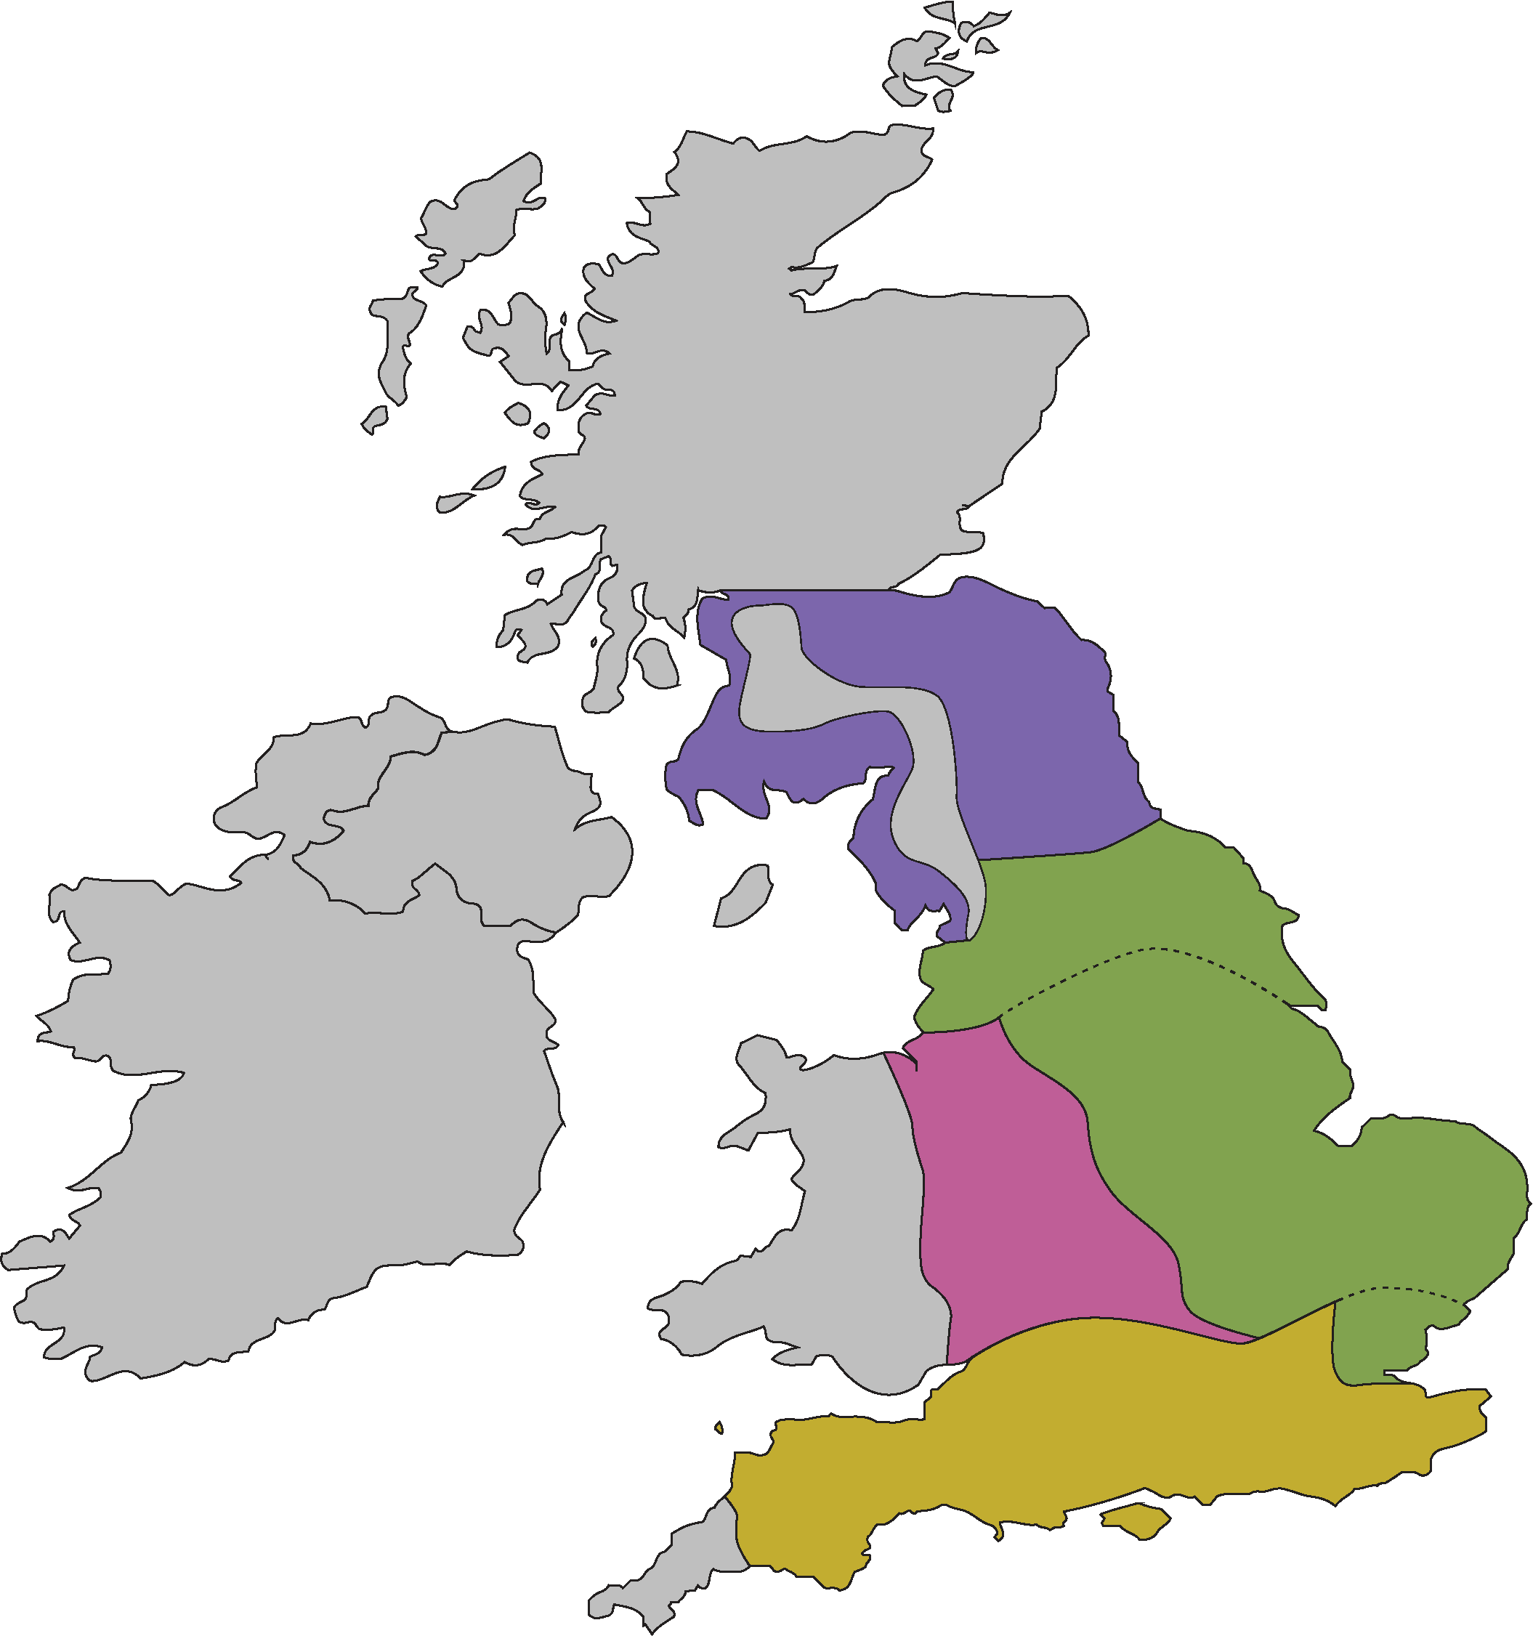
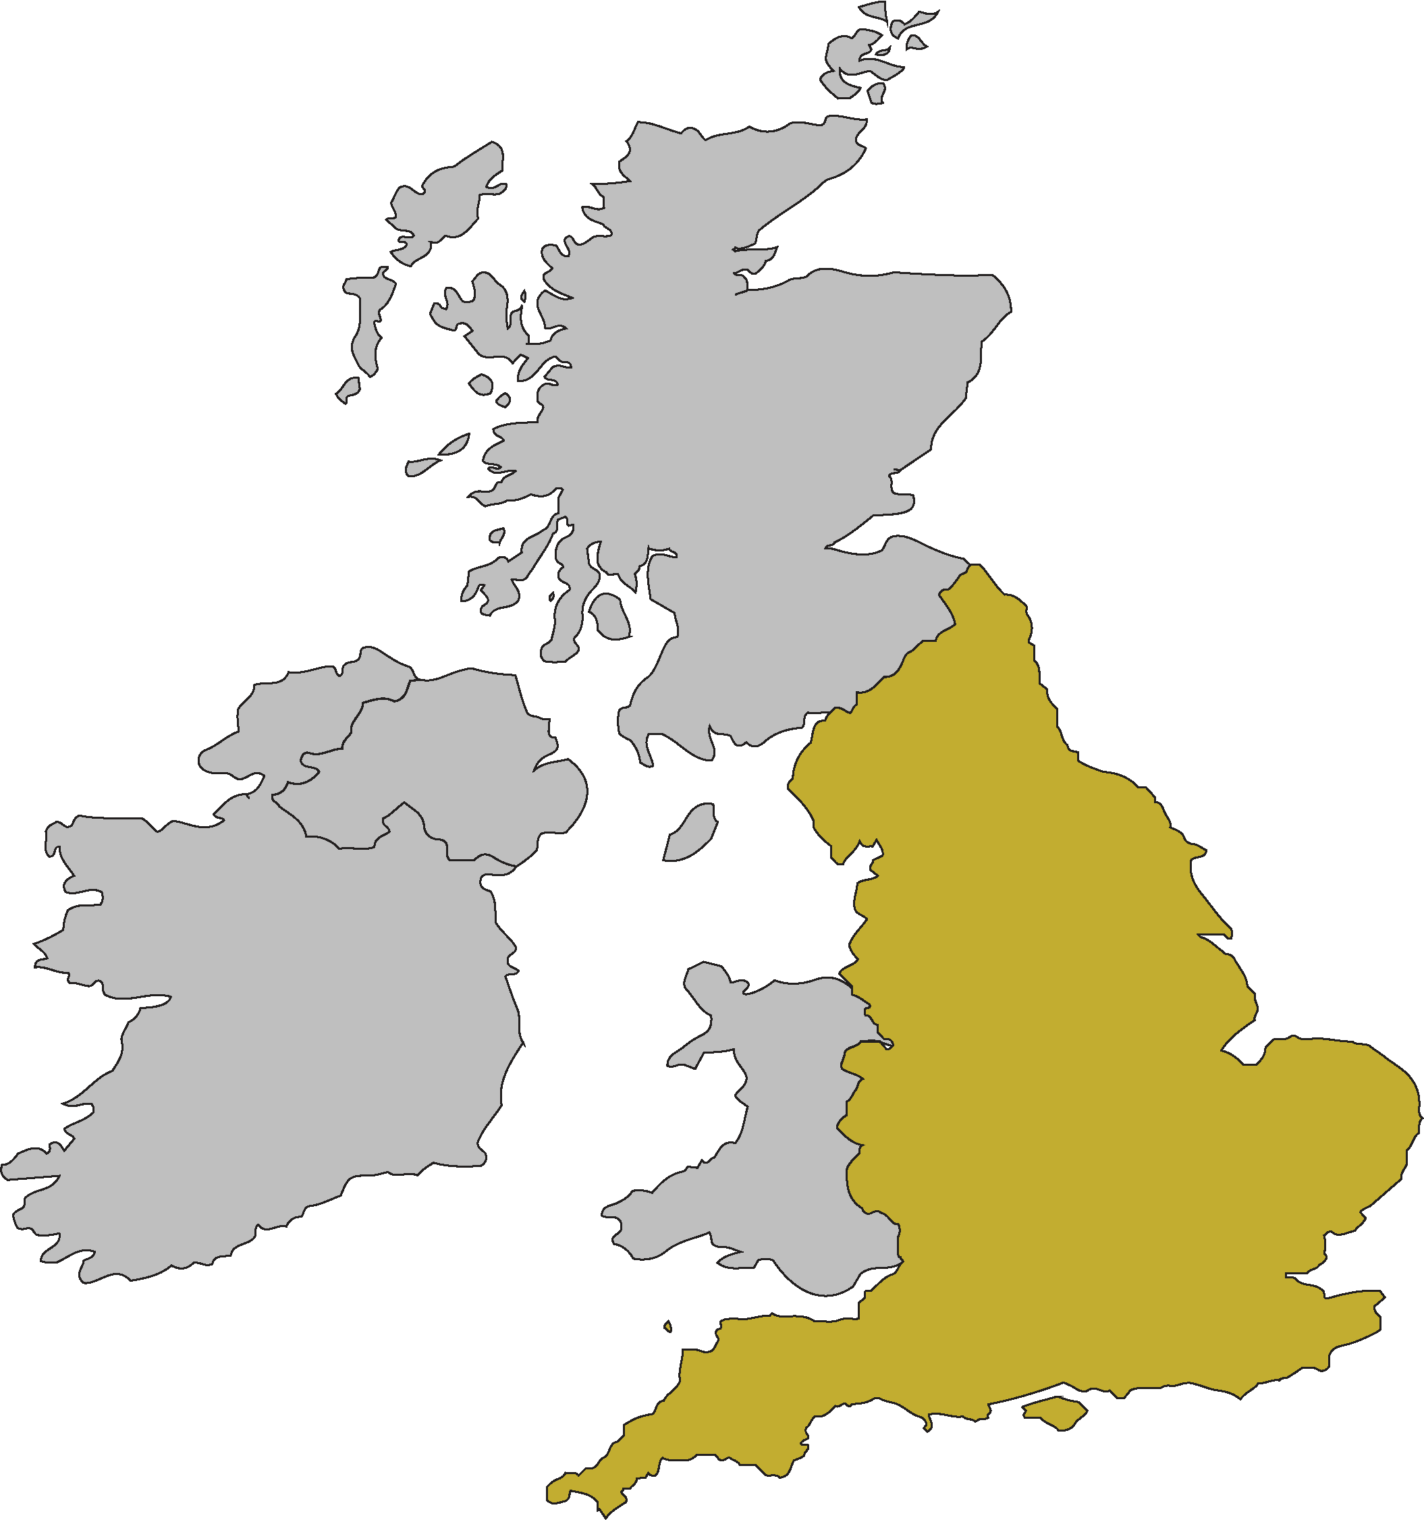
Viking Age
England
Timeline of Vikings in England
878
Danelaw established
865
Great Heathen Army arrived
954
Anglo-Saxons defeat the Vikings and Danelaw ends
1017
Cnut becomes the first of three Viking kings of England who ruled until 1042.
850
Vikings started to settle in England
Anglo-Saxon king at Sutton Hoo was buried
793
Raid on Lindisfarne
400
500
600
700
800
900
1000
1100
Key knowledge
Key vocabulary
The Vikings were groups of people from Scandinavia who were most active in 9th and 10th centuries. Most were farmers who lived in longhouses.
The Vikings were very successful sailors and sailed in longships all around Europe and Asia and as far as North America.
The Vikings believed in multiple gods, like Odin, Thor and Loki. They believed these gods lived in Asgard.
The Vikings believed in an afterlife for warriors called Valhalla, which would end one day. They were buried with grave goods that could be used in Valhalla.
The Vikings gradually converted to Christianity.
The Vikings made and traded goods across Europe and beyond, and they participated in a slave trade.
The Vikings could be presented as violent warriors or noble explorers, depending on who was writing and when. But really, not all Vikings were the same and, in reality, they probably had both brutal and peaceful elements.
Danelaw: (Noun) the part of Britain that was controlled by the Vikings from 878 to 954.
Lindisfarne: (Noun) a small island off the northeast coast of England, which was once home to a monastery that was raided by the Vikings in 793.
longhouse: (noun) a Viking house.
longship: (noun) Viking ships that were long and shallow, and so easy to sail and to travel up rivers.
Norse: (Noun/Adjective) someone who comes from Scandinavia / describing something that comes from Scandinavia.
raid: (verb) to surprise an enemy with an attack, and often to steal from them.
Scandinavia: (Noun) a group of countries in northern Europe that includes Denmark, Norway and Sweden.
thing: (noun) a Viking assembly that was the system of administration and justice.
History | Year 6 – Spring Term | Knowledge Organiser
Notes:
Icons: Powerpoint
Maps: United Learning

