Slide 1
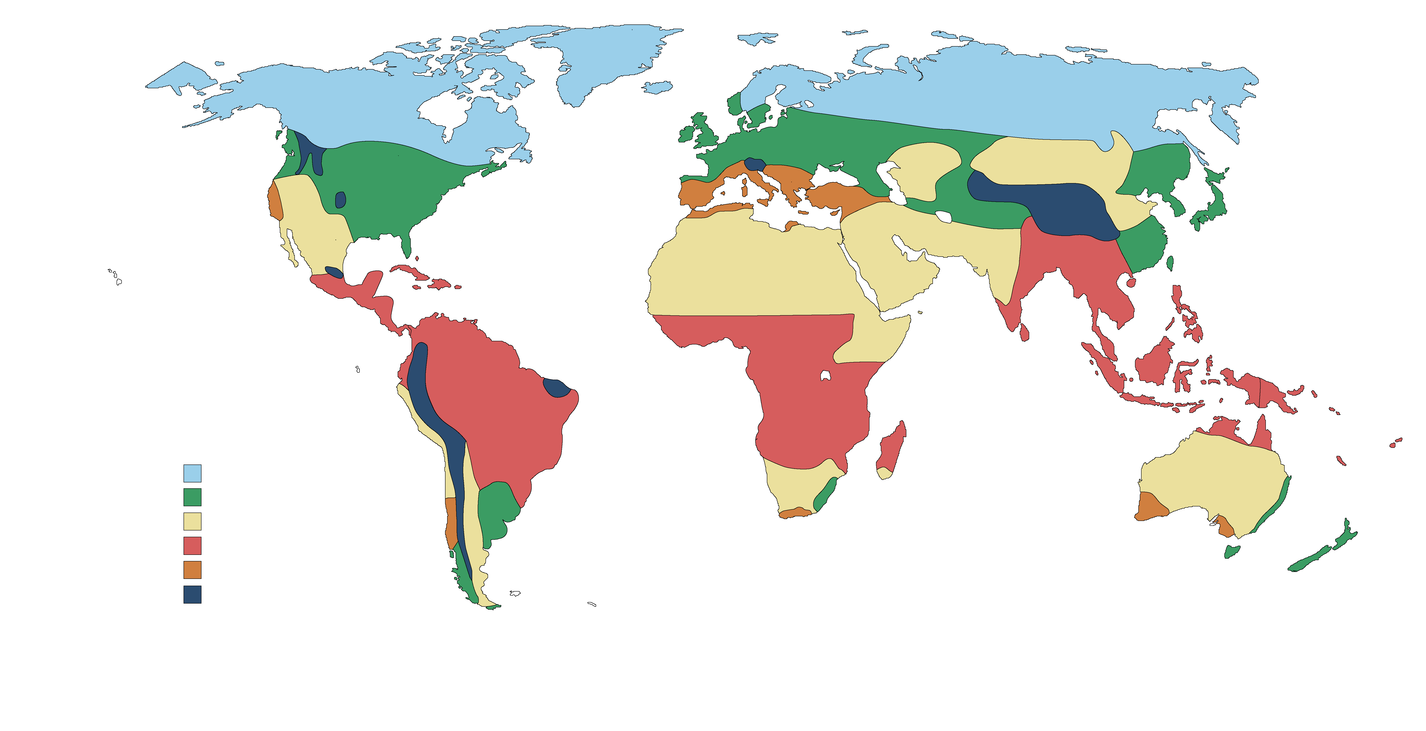
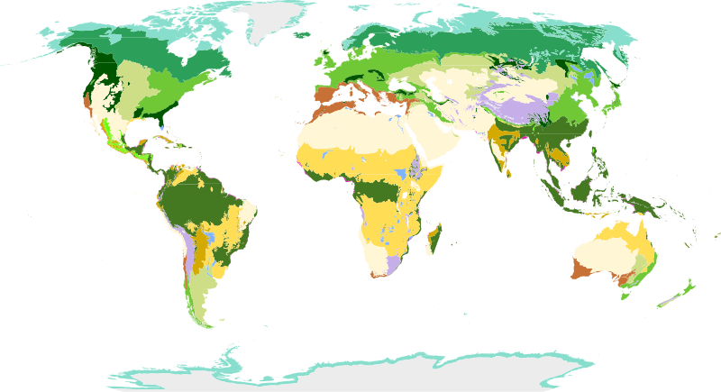
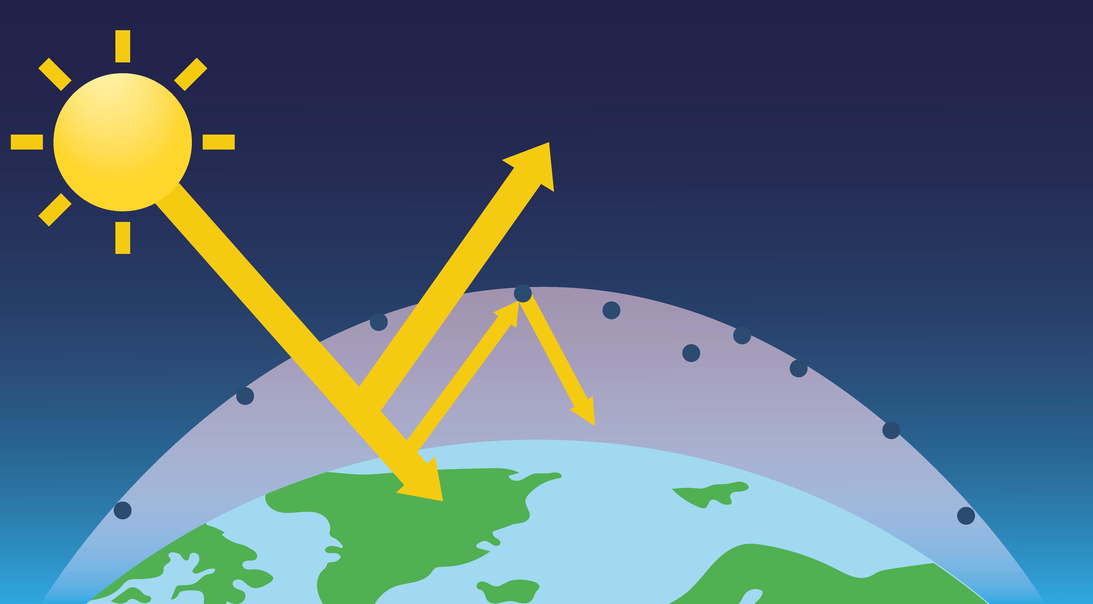
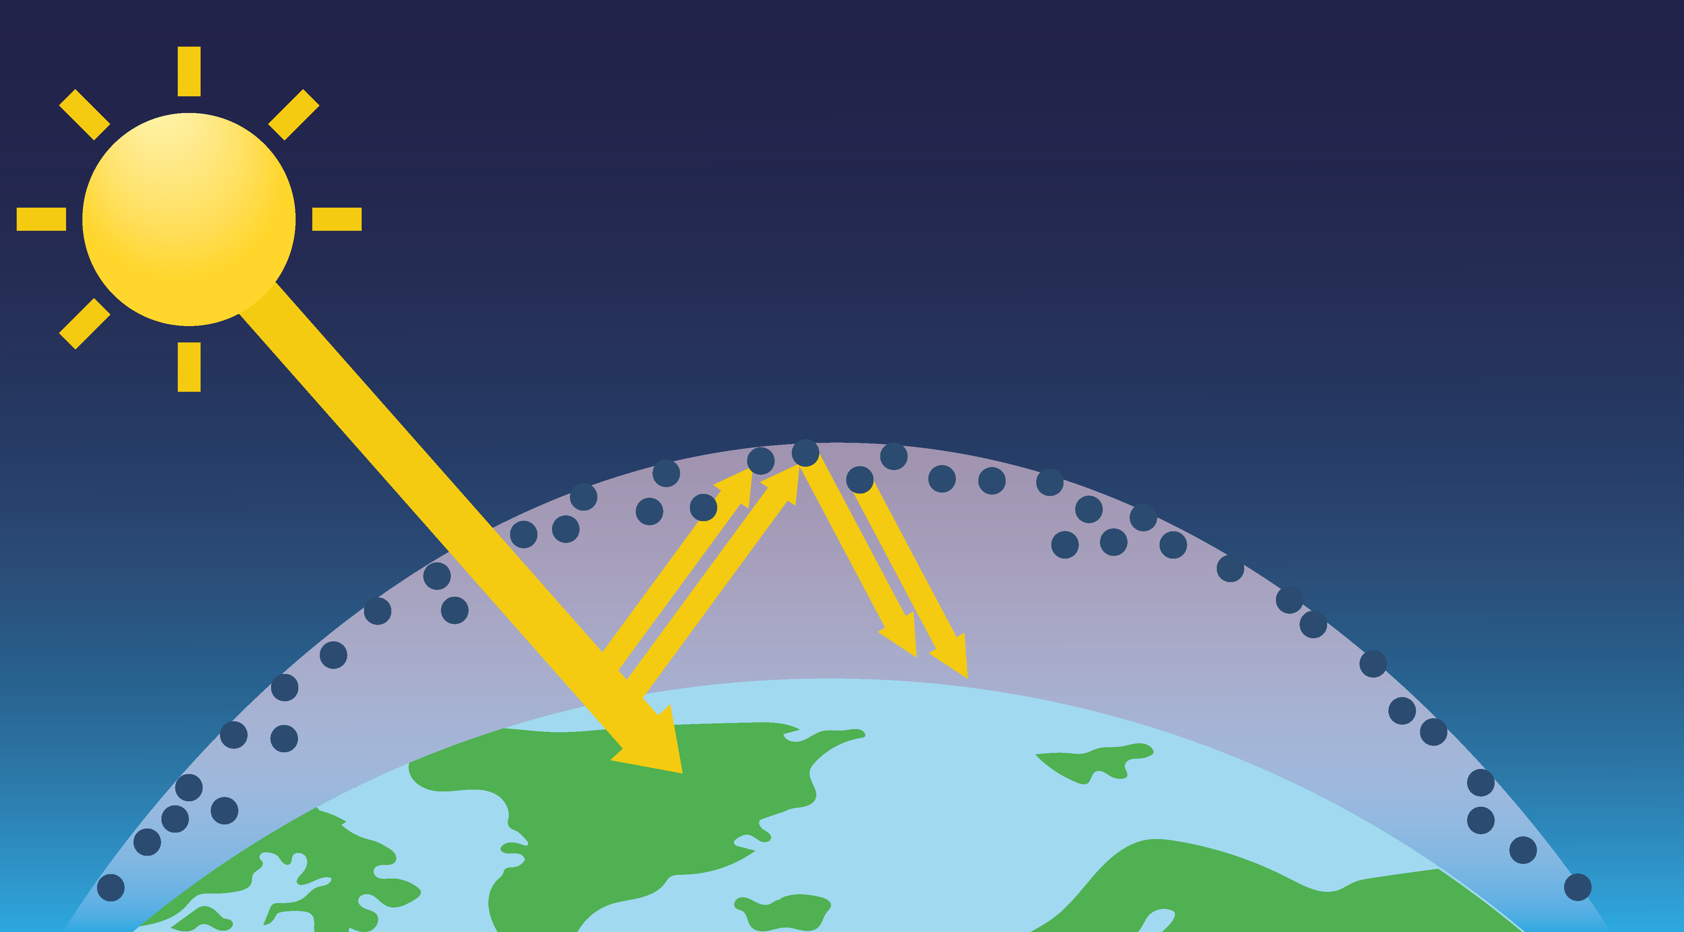
Climate across the world
Climate zones
Biomes and vegetation belts
Climate zones are areas in the world that have a similar climate. There are several major climate zones in the world. The main six are shown on this map.
The climate zones generally group together horizontally, following lines of latitude.
Biomes are areas of the world that, because of their similar climates, have similar landscapes and wildlife. Biomes are shown on the map
Vegetation belts are areas with distinct plant life within one or more biomes.
 | polar
 | temperate
 | arid
 | tropical
 | Mediterranean
 | mountains
 | tundra
 | taiga
 | alpine
 | Mediterranean
 | hot deserts
 | cold desert
 | temperature forest
 | tropical rainforest
 | savanna grasslands
Global warming and climate change
The greenhouse effect is the natural process that has always taken place, which keeps the Earth warm. Without it, the Earth would be too cold to live on!
The Sun’s rays are trapped in the atmosphere by greenhouse gases, like carbon dioxide. This warms the Earth.
The enhanced greenhouse effect causes an unnatural increase in temperature. Human activities (like burning fossil fuels, transport, waste, agriculture, deforestation) increase the amount of greenhouse gases in the atmosphere. The Earth warms more quickly. Global warming increases.
Accelerated global warming can also lead to other changes in the Earth’s long-term weather patterns, such as precipitation, wind and storms. The changes to the Earth’s wider climate – not just temperature – are called climate change.
Climate change can cause:
more extreme weather events, like droughts and heatwaves
melting sea ice and loss of habitats
rising sea levels and the flooding of coastal areas
Some biomes and species are more at risk of being impacted by climate change. These are called vulnerable biomes (like the tundra) or vulnerable species (like the dormouse).
Terpsichores, CC BY-SA 3.0, via Wikimedia Commons
Geography | Year 5 – Summer Term | Knowledge Organiser
Notes:
Biomes of the world (CC BY-SA 3.0) – https://commons.wikimedia.org/wiki/File:Biomes_of_the_world.svg
All Other images – United Learning

