Slide 1
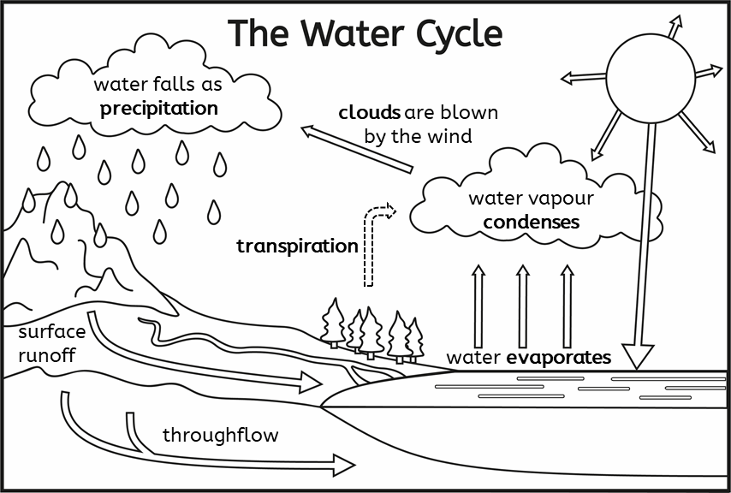
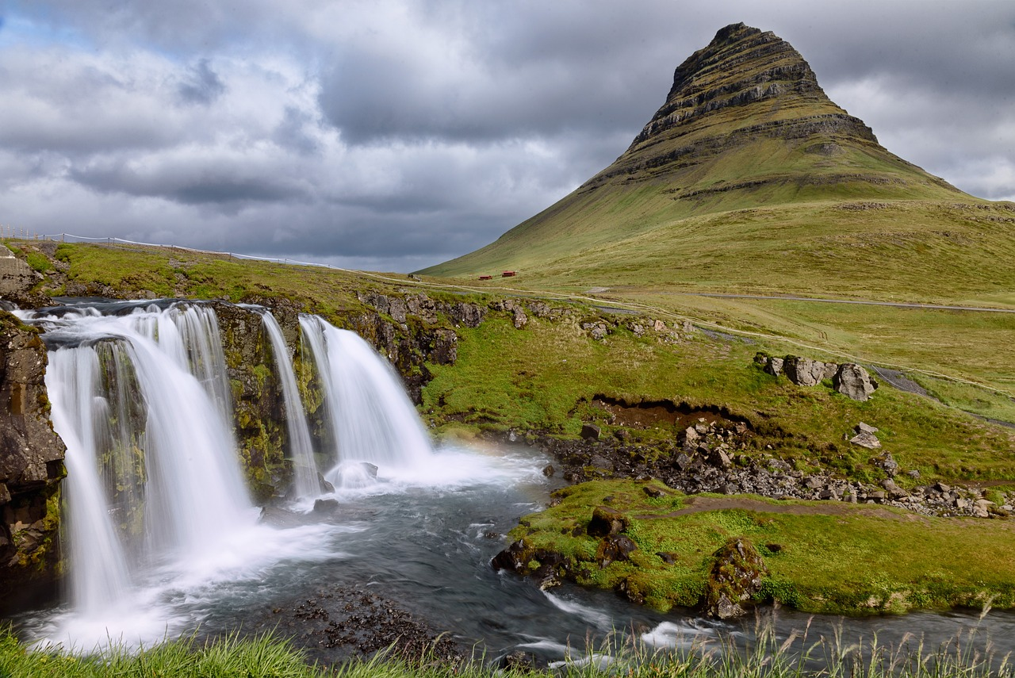
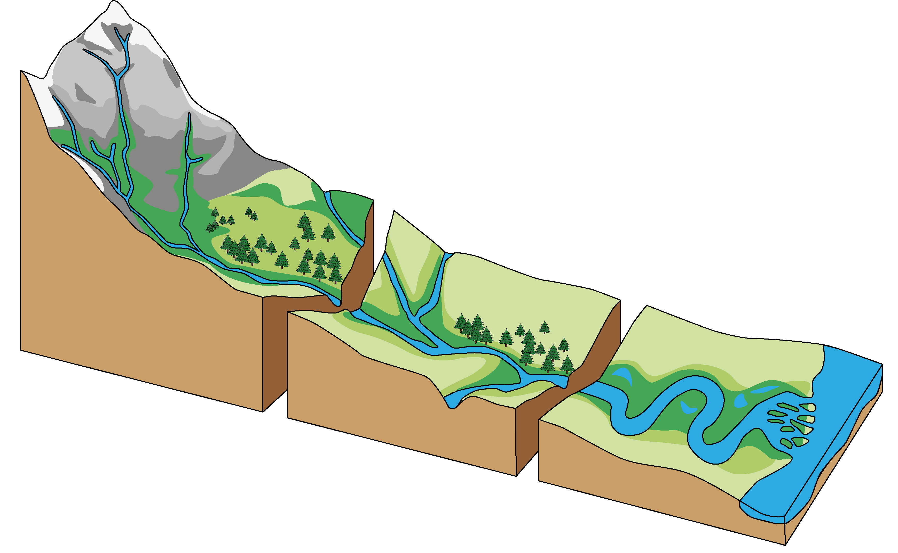
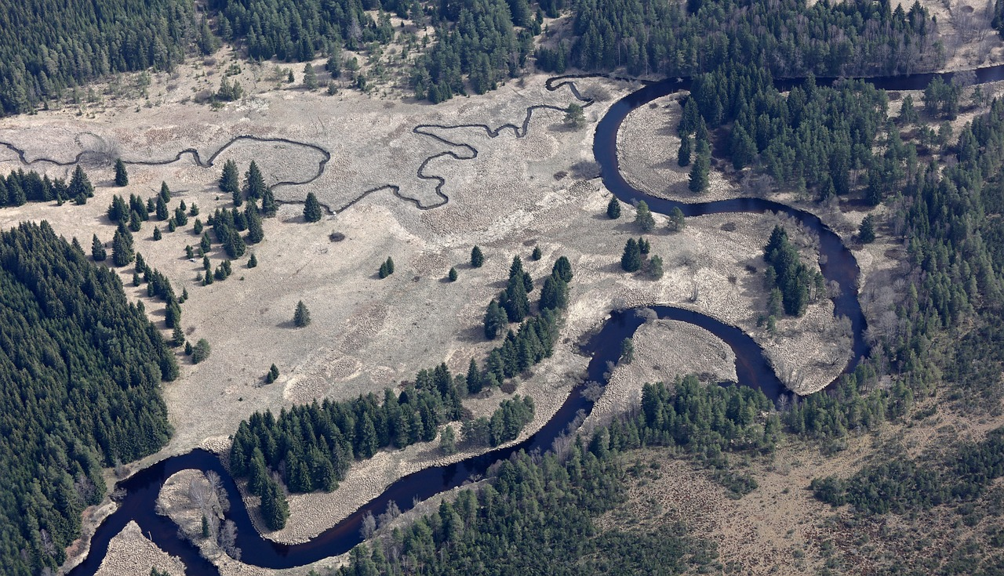
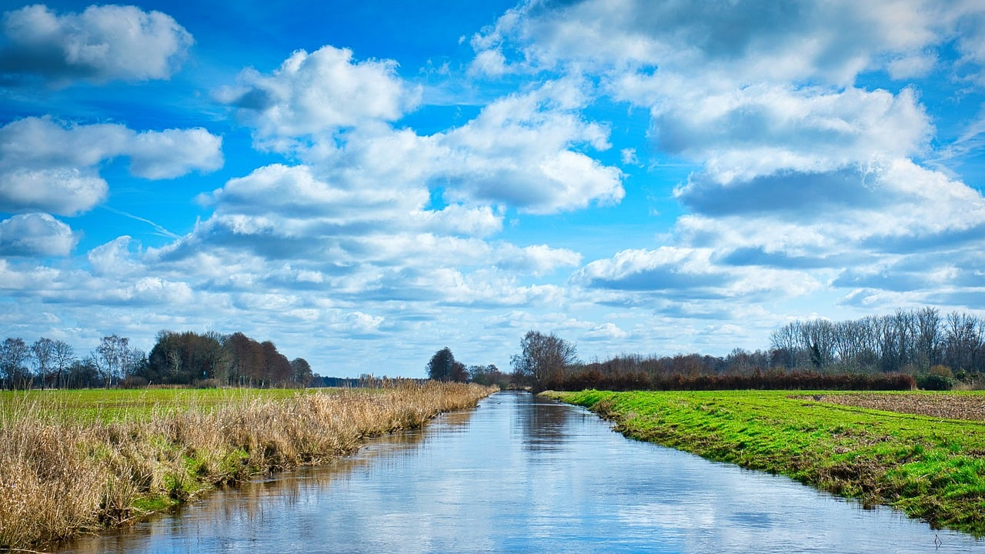
Looking at North America and water
The water cycle
The importance of water
There is a fixed amount of water on our planet and we use it for lots of things, from drinking and washing to producing foods and goods.
Most of the water on the Earth is saltwater, stored in oceans and seas.
The freshwater that we have is mostly stored as ice or underground.
Rivers
source
waterfalls
meanders
floodplains
Key vocabulary
erode (verb): to gradually wear away
floodplain (noun): the flat land either side of a river in the lower course. When the river floods, it deposits nutrients, so this is land that is very good for agriculture
meander (noun): bend in a river, usually in the middle and lower courses, caused by gradual erosion
surface runoff (noun): the flow of water on the Earth’s surface. It is faster than throughflow
throughflow (noun): the flow of water underground, beneath the Earth’s surface. It is slower than surface runoff
transpiration (noun): the evaporation of water from the soil through plants’ and trees’ leaves
mouth
upper course
near the source
fast-flowing water
narrow
mountainous land
middle course
sea or ocean
features of both the other courses
lower course
near the mouth
slow-flowing water
wide
flat land
Geography | Year 5 – Spring Term | Knowledge Organiser
Notes:
The water cycle and long profile of a river – United Learning
A waterfall (CC0) – https://pixabay.com/fr/photos/grundarfj%C3%B6r%C3%B0ur-kirkjufell-montagne-3516524/
Meanders (CC0) – https://pixabay.com/fr/photos/serpente-vltava-umava-fleuve-for%C3%AAt-1316547/
Floodplain (CC0) – https://pixabay.com/fr/photos/couler-cours-de-la-rivi%C3%A8re-leau-7844376/

