Slide 1
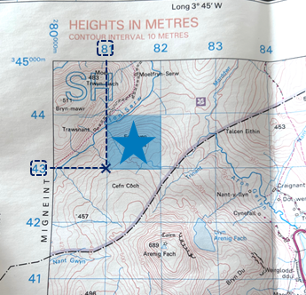

Investigating World Trade
Trade
Natural resources
Trade is the process of buying and selling natural resources and goods.
Imports are goods that are brought into the country. Exports are goods that are traded out of the country.
Over time, trade has become more and more global.
Natural resources are materials that occur naturally in the environment, like wood, food, water and fossil fuels.
Fossil fuels are materials made from fossils over millions of years, like coal and oil. Humans use these to run cars and electrical appliances.
Natural resources can be renewable (they will not run out) or non-renewable (they will run out).
Employment industries
Primary: Industries that collect or extract natural resources from the environment.
Secondary: Industries that manufacture goods into products.
Tertiary: Industries that provide a service.
Quaternary: Industries that involve using technology and research.
Four-figure grid references
Four-figure grid references are used to describe locations on an OS map.
Look at the bottom left corner of the square.
Find the easting.
Find the northing.
Write down the four-digit grid reference.
Fairtrade
Fairtrade is an organisation that supports farmers receiving fair prices and good working conditions.
Geography | Year 5 – Autumn | Knowledge Organiser
Notes:
Fairtrade logo (CC0) – https://commons.wikimedia.org/wiki/File:Fairtrade-logo.jpg

